Slide 1

What’s new in .NET world?
Miroslav Popović
Technical Lead @Seavus @miroslavpopovic https://miroslavpopovic.com/ https://github.com/miroslavpopovic/

Slide 2
Agenda
.NET languages, BCL, SDK, tools, performance
EF Core, ASP.NET Core, Blazor, gRPC, MAUI, desktop…
Broader ecosystem
Covering .NET 7 and 8, from 2022., onwards
https://github.com/miroslavpopovic/what-is-new-in-dotnet

Slide 3



Languages

Slide 4
C# 11 (.NET 7)
Raw string literals
No character escaping
At least three double quotes “””...”””
Can be interpolated by using $ prefixes
$, $$, $$$
number of $s defines the number of curly braces in content
New lines inside the “holes” of interpolated strings
Required members (public require string Name { get; init; })
Generic attributes
File-scoped types
…
Notes:
https://github.com/dotnet/csharplang
https://learn.microsoft.com/en-us/dotnet/csharp/whats-new/csharp-11

Slide 5
C# 12 (.NET 8)
Primary constructors for non-record classes and structs
Using aliases for any type
Default values for lambda expression parameters
...
Notes:
https://github.com/dotnet/csharplang/tree/main/proposals
https://learn.microsoft.com/en-us/dotnet/csharp/whats-new/csharp-12

Slide 6
F# 7
Static abstract members in interfaces
Required properties checking, init scope and init-only parameters
F# self-contained deployment
Native AOT
…
Notes:
https://devblogs.microsoft.com/dotnet/announcing-fsharp-7/

Slide 7
F# 8
F# inline types and parameter name hints in Visual Studio
Notes:
https://devblogs.microsoft.com/dotnet/fsharp-inline-hints-visual-studio/

Slide 8
Visual Basic
No new features, other than shared .NET ones
Some improvements in Visual Studio 2022, like refactorings
WinForms Visual Basic Application Framework has new features

Slide 9
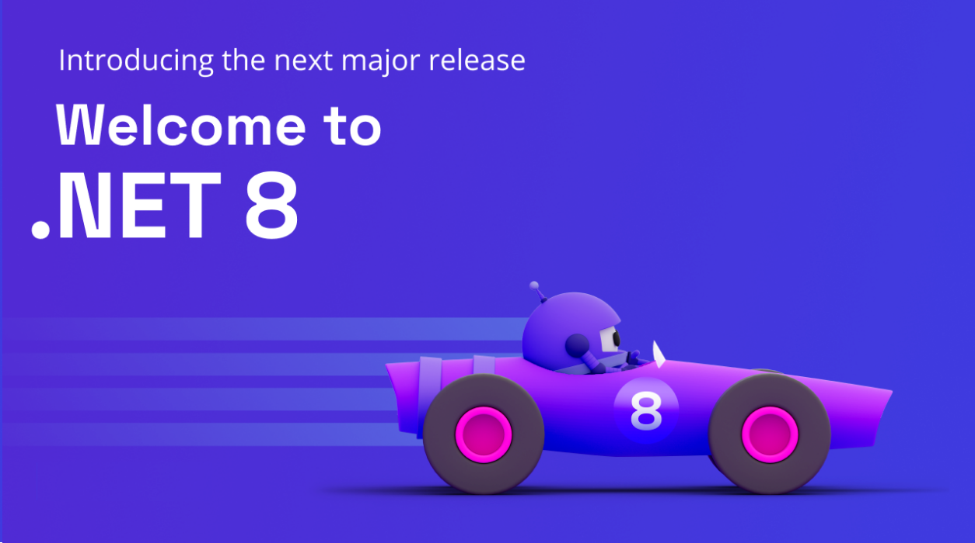
BCL and tools

Slide 10
New library APIs in .NET 7
Generic math
System.Numerics
INumber<T>, IBinaryInteger, IFloatingPoint, IFloatingPointIeee754, INumberBase, ISignedNumber
Separate interfaces for functions and operators – like IAdditionOperators
C# feature - using static abstract methods in interfaces
New Regex APIs
RegexGenerator and Roslyn analyzers
A lot of other improvements
Rate limiting
Concurrency, token bucket, fixed window, sliding window, partitioned...
System.Threading.RateLimiting
…
Notes:
https://learn.microsoft.com/en-us/dotnet/core/whats-new/dotnet-7
https://devblogs.microsoft.com/dotnet/announcing-dotnet-7/

Slide 11
System.Text.Json in .NET 7
Polymorphism
JsonDerivedType
JSON contract customization
Adding type modifiers to DefaultJsonTypeInfoResolver
Creating custom IJsonTypeInfoResolver
Conditional property serialization
…

Slide 12
New library APIs in .NET 8
Native AOT improvements
Reduced size of the single file apps
Templates with Native AOT support - dotnet new console --aot (also Worker and Minimal APIs)
New performance focused types in the core libraries
FrozenDictionary<TKey, TValue> and FrozenSet<T>
System.ComponentModel.DataAnnotations extensions
RequiredAttribute.DisallowAllDefaultValues - prevents Guid.Empty, 0, false, etc. from being valid
LengthAttribute can now set both upper and lower bounds for strings and collections
New AllowedValuesAttribute and DeniedValuesAttribute
New Base64StringAttribute
TimeProvider abstract class for time abstraction
Supported in Task.Delay, Task.Async…
New configuration binding source generator
Avoids reflection at runtime, and enables Native AOT scenarios
CodeGen improvements
…

Slide 13
System.Text.Json in .NET 8
Populating read-only members during deserialization
JsonUnmappedMemberHandling
for missing member handling
Support for interface hierarchies
Support for snake_case and kebab-case property names
JsonSerializer.IsReflectionEnabledByDefault
Helps with Native AOT
Not all serialization options are supported – i.e., dynamic types are not
…

Slide 14
.NET 7 SDK
Native AOT
New CLI parser
Central Package Management
Directory.Packages.props
…
Notes:
https://learn.microsoft.com/en-gb/dotnet/core/deploying/native-aot/

Slide 15
.NET 8 SDK
Simplified build output path
Using /artifacts folder by default
dotnet publish and dotnet pack produce Release output by default
dotnet build /tl – new, modern terminal build output
dotnet workload clean
.NET container images improvements
Debian 12 (Bookworm) used as a default Linux distro
Using Ubuntu Chiseled container
Running as a non-root user – app
Using port 8080 by default (doesn’t require root)
Expanded container build from .NET CLI
Registry authentication, multi-platform images, rootless containers

Slide 16
Tools .NET 7
Hot Reload improvements
For Blazor WebAssembly, iOS and Android
NuGet 6.4
Central Package Management, GlobalPackageReference
Improved VS performance
Notes:
https://devblogs.microsoft.com/dotnet/announcing-net-7-preview-1/
https://devblogs.microsoft.com/nuget/announcing-nuget-6-4-signed-central-delivered/

Slide 17
Tools .NET 8
Hot Reload supports modifying generics
Upgrade Assistant getting more capable and available from Visual Studio
Notes:
https://devblogs.microsoft.com/dotnet/hot-reload-generics/
https://devblogs.microsoft.com/dotnet/upgrade-assistant-now-in-visual-studio/

Slide 18

Performance improvements

Slide 19
Performance improvements in .NET 7
Improvements in existing CodeGen / JIT features
Regex source generator and other regex performance improvements
Arrays, strings, Collections and Spans
LINQ Min, Max, Sum, Average
JSON, XML, Compression, Cryptography, Diagnostics, Exceptions
...
Notes:
https://devblogs.microsoft.com/dotnet/performance_improvements_in_net_7/
https://devblogs.microsoft.com/dotnet/arm64-performance-improvements-in-dotnet-7/
https://devblogs.microsoft.com/dotnet/announcing-dotnet-7/#performance
https://www.techempower.com/benchmarks/#section=data-r21&hw=ph&test=plaintext
https://dusted.codes/how-fast-is-really-aspnet-core

Slide 20
Performance improvements in .NET 8
Native AOT
…

Slide 21

Entity Framework Core

Slide 22
New in EF Core 7
JSON columns in relational databases
Bulk updates
Performance improvements on inserts and updates (SaveChanges)
Map CUD operations to stored procedures
Table-per-concrete-type (TPC) mapping
...
Notes:
https://learn.microsoft.com/en-gb/ef/core/what-is-new/ef-core-7.0/whatsnew
https://devblogs.microsoft.com/dotnet/announcing-ef7/

Slide 23
New in EF Core 8
Raw SQL queries for unmapped types
Lazy loading for no-tracking queries
DateOnly/TimeOnly support on SQL Server
JSON columns in SQLite
SQL Server HierarchyId support
Translating LINQ Contains to OpenJson query
…
Notes:
https://learn.microsoft.com/en-us/ef/core/what-is-new/ef-core-8.0/whatsnew

Slide 24


ASP.NET Core

Slide 25
ASP.NET Core 7 features
RateLimiting middleware
Output caching middleware
Incremental ASP.NET migration tooling
Authentication improvements
Kestrel improvements
…
Notes:
https://devblogs.microsoft.com/dotnet/incremental-asp-net-migration-tooling-preview-2/
https://devblogs.microsoft.com/dotnet/announcing-rate-limiting-for-dotnet/#ratelimiting-middleware
https://blog.maartenballiauw.be/post/2022/09/26/aspnet-core-rate-limiting-middleware.html

Slide 26
Minimal APIs in ASP.NET Core 7
IEndpointFilter support
IFormFile and IFormFileCollection
IResult implementations are now public for improved testability
Typed results – Microsoft.AspNetCore.Http.TypedResults
Self-describing minimal APIs
Route groups with MapGroup()
…
Notes:
https://csharp.christiannagel.com/2023/05/03/minimal-api-growing-with-net-7/

Slide 27
ASP.NET Core 8 features
Improved authentication and authorization experience
Native AOT support
Only partially, available for Minimal APIs and Worker Service
Top level APIs annotated for trim warnings
Route tooling
Roslyn based, should work on any IDE
Route syntax highlighting
Autocomplete for parameters, route names and constraints
Route analyzers and fixers
Request timeouts middleware
Available for individual endpoints, controllers, or dynamically per request
Kestrel and HttpSys connection improvements
Notes:
https://github.com/dotnet/aspnetcore/issues/44984

Slide 28
Minimal APIs in ASP.NET Core 8
Request Delegate Generator source generator
No need for [FromForm] attribute when binding parameters
API project templates include .http file
This is available for controller-based Web API projects too
…

Slide 29
SignalR in .NET 7
Client source generator
Dependency injection for hub methods
…
Notes:
https://devblogs.microsoft.com/dotnet/asp-net-core-updates-in-net-7-preview-1/#signalr-client-source-generator

Slide 30

Blazor

Slide 31
New features in .NET 7
Support for System.Security.Cryptography
Blazor custom elements are no longer experimental
QuickGrid component [experimental]
https://aspnet.github.io/quickgridsamples/
New loading page
Interoperability between .NET 7 and JavaScript through .NET WebAssembly runtime
WebAssembly multithreading [experimental]
Notes:
https://www.infoq.com/news/2022/10/javascript-interop-dotnet-7-rc-1/

Slide 32
New features in .NET 8
(Just) Blazor
Previously, “Blazor United” or “Full stack web UI with Blazor”
Server-side and streaming rendering with Blazor components
Rendering Razor components outside of ASP.NET Core
QuickGrid no longer experimental – part of .NET 8
Experimental Webcil format for .NET assemblies
Improved Blazor WebAssembly performance with jiterpreter
…
Notes:
https://www.telerik.com/blogs/big-changes-coming-blazor-dotnet-8

Slide 33
Demo
Check Microsoft Build 2023 session
“What’s new in .NET 8 for Web frontends, backends, and futures? | BRK200H” by Daniel Roth and Jeremy Likness
https://youtu.be/pJGDPEk45Jc

Slide 34

MAUI

Slide 35
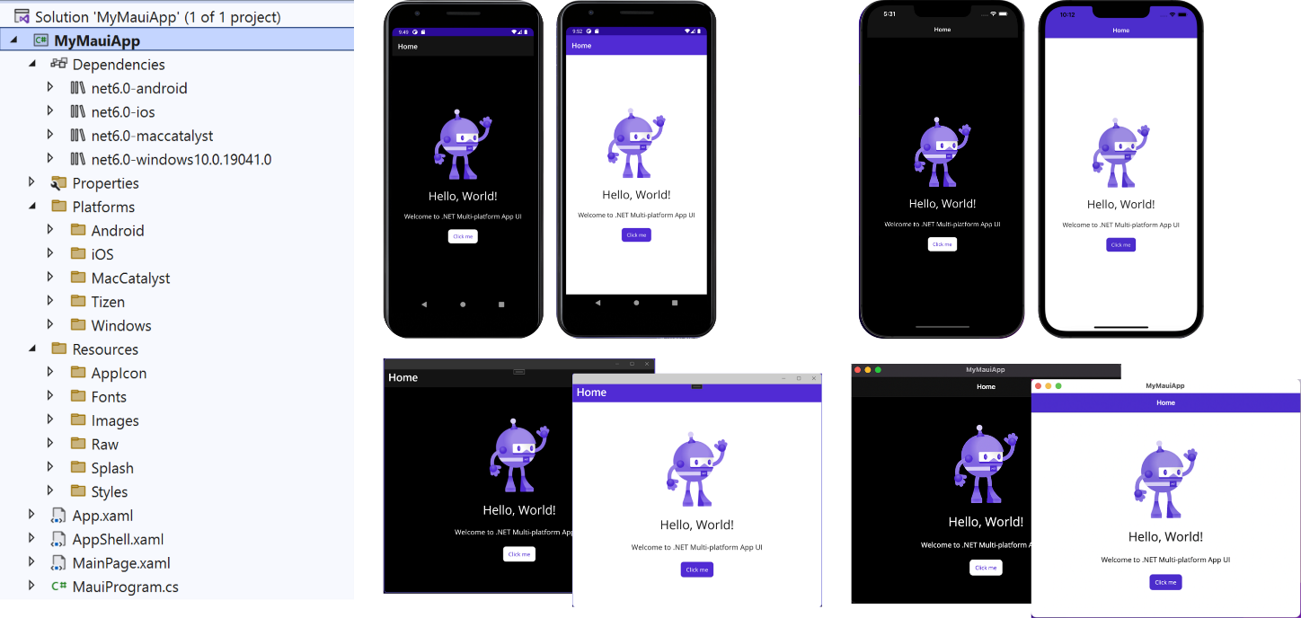
Xamarin.Forms => MAUI
Support for iOS, Android, macOS, Windows, Tizen
Single project, using platform folders
Sharing code and resources cross-plat
Images, icons, fonts, manifests
Host model using IAppHostBuilder
Dependency injection and lifecycle events
Shared MauiApp class, per-platform apps
Hot Reload support
Essentials (previously Xamarin.Essentials)
for common device features is included in core
.NET MAUI Community Toolkit
Third-party components – DevExpress, Syncfusion, Telerik...
…
Notes:
https://dotnet.microsoft.com/en-us/apps/maui

Slide 36
MAUI in .NET 8
Improving quality - resolving issues, merging pull requests
Most attention was given to CollectionView, Shell and drawing (shapes, shadows, clipping)
Improving memory management
New version of .NET Upgrade Assistant supports Xamarin.Forms upgrade to .NET MAUI
…
Notes:
https://github.com/dotnet/maui/wiki/Roadmap

Slide 37
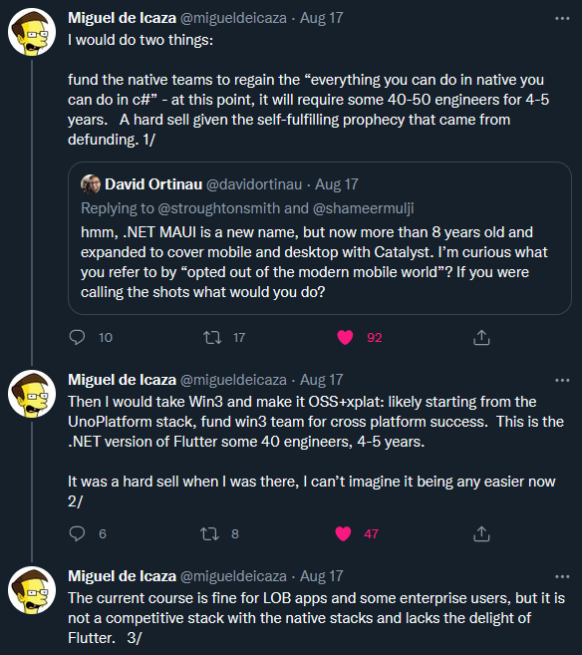


Is it ready?
No out-of-the-box support for Linux
Unstable
Notes:
https://visualstudiomagazine.com/articles/2022/09/29/net-maui-complaints.aspx
https://twitter.com/migueldeicaza/status/1559898665350832128

Slide 38
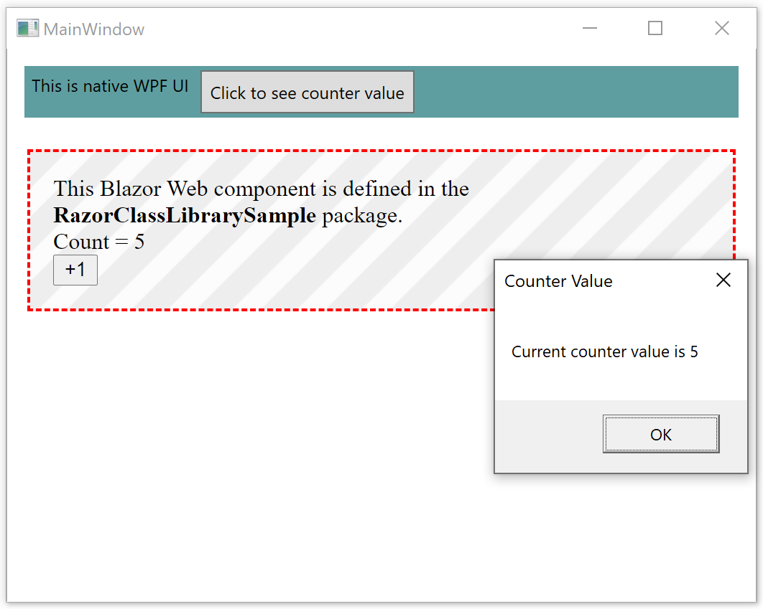
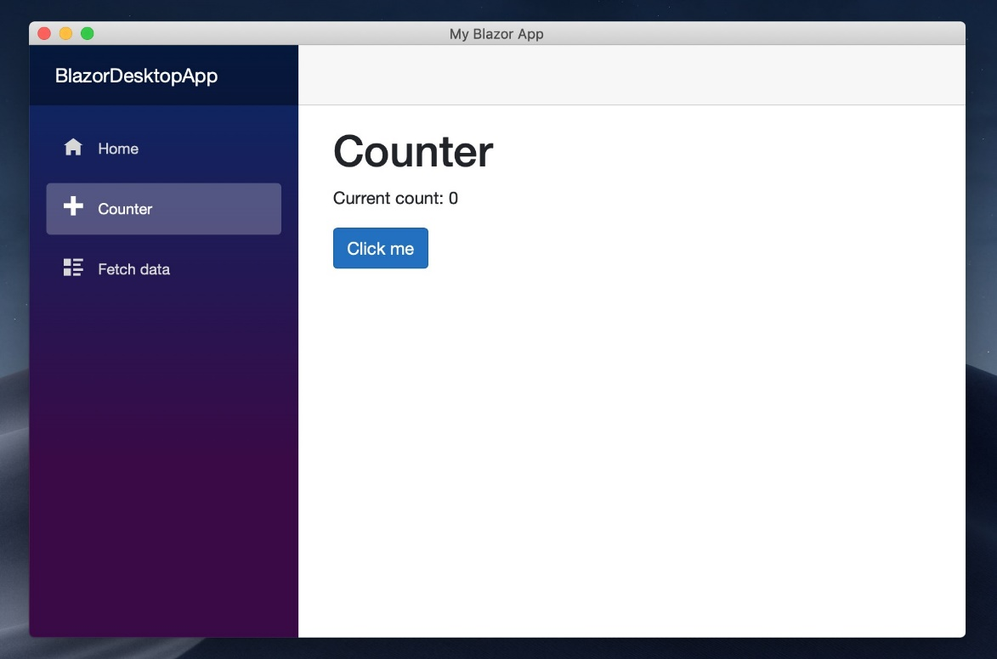
Blazor Hybrid
Running natively on Windows and macOS via MAUI
BlazorWebView for WPF and Windows Forms

Slide 39



Alternatives
Uno platform - https://platform.uno/
Avalonia UI - https://avaloniaui.net/
Flutter - https://flutter.dev/
Notes:
https://platform.uno/blog/top-50-reasons-to-use-uno-platform-2022-edition/

Slide 40

Other

Slide 41

gRPC in .NET 7
JSON transcoding
Use gRPC services like RESTful HTTP APIs
Notes:
https://devblogs.microsoft.com/dotnet/announcing-grpc-json-transcoding-for-dotnet/

Slide 42
gRPC in .NET 8
JSON transcoding no longer requires http.proto and annotations.proto
Native AOT support for both client and server apps

Slide 43
Desktop in .NET 7
Windows Forms
Accessibility improvement and fixes
High DPI and scaling improvements
Databinding improvements
Using MVVM with WinForms
Custom controls for WinForm’s out-of-process designer
WPF
Performance improvements
Accessibility improvements
Template updates
Notes:
https://devblogs.microsoft.com/dotnet/winforms-enhancements-in-dotnet-7/
https://devblogs.microsoft.com/dotnet/wpf-on-dotnet-7/

Slide 44
Desktop in .NET 8
?

Slide 45
Monitoring and metrics in .NET 8
Metrics added for ASP.NET Core hosting, Kestrel and SignalR
A new Azure Monitor OpenTelemetry distro library
Enables monitoring ASP.NET Core apps with Azure Monitor, based on the infrastructure of OpenTelemetry for .NET
Notes:
https://devblogs.microsoft.com/dotnet/announcing-dotnet-7-preview-4/#added-metrics-for-microsoft-extensions-caching

Slide 46

Broader ecosystem

Slide 47

CoreWCF
1.0 released in April 2022.
Community project
Features are a subset of functionality from WCF
.NET Upgrade Assistant is able to migrate WCF services to CoreWCF
Notes:
https://devblogs.microsoft.com/dotnet/corewcf-v1-released/
https://devblogs.microsoft.com/dotnet/corewcf-1-1-0-and-project-templates/

Slide 48
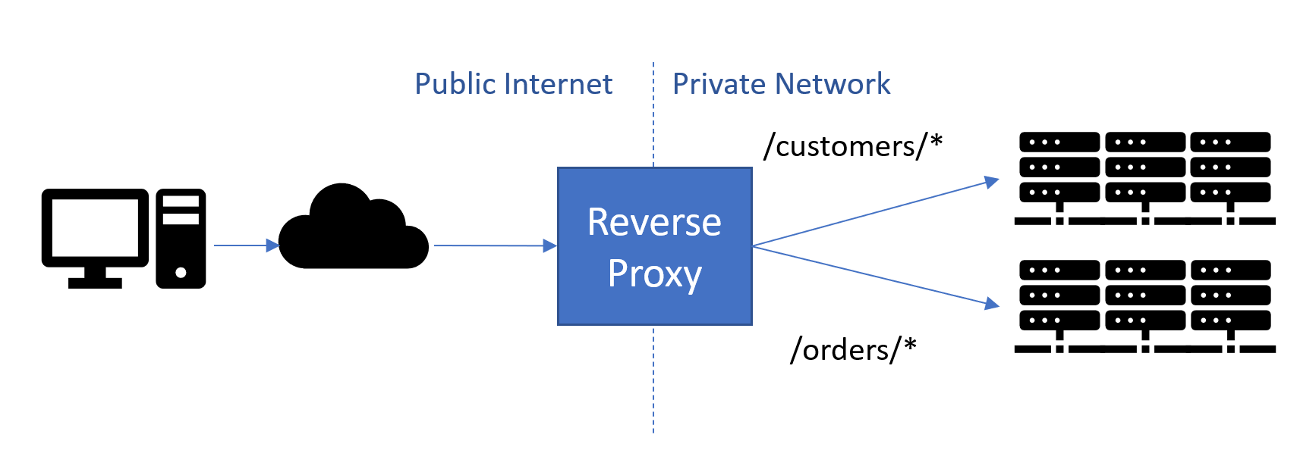
YARP
YARP = Yet another reverse proxy
Configuration via static config files, or programmatic
Load balancing
Authentication and authorization
HTTP/3 support
Proxying URLs and header transformation
Cloud-scale performance
Easily extensible
Open-source
…
Notes:
https://devblogs.microsoft.com/dotnet/announcing-yarp-1-0-release/

Slide 49
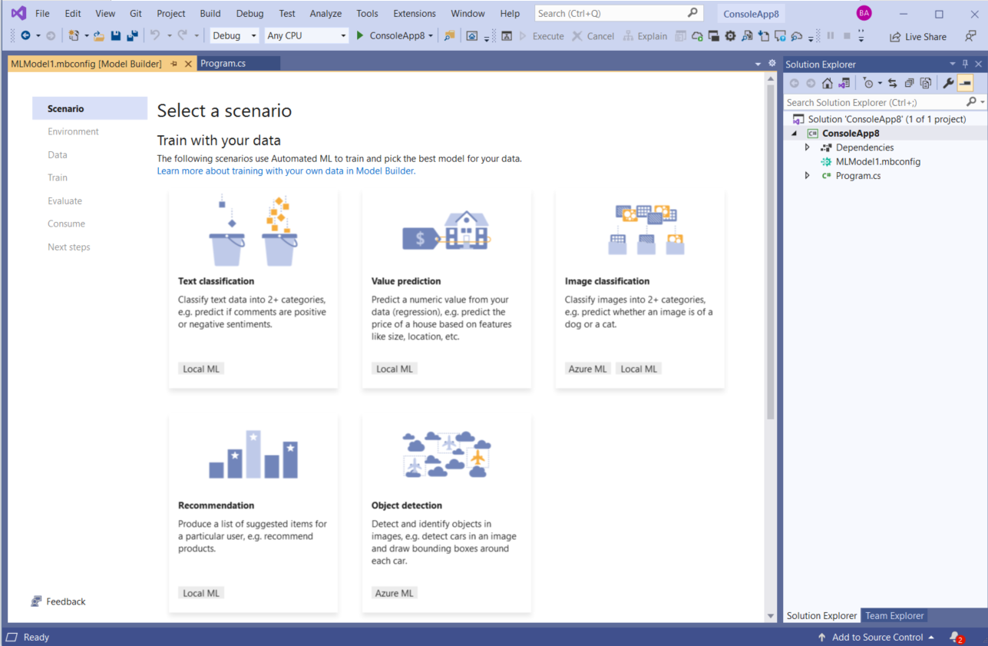
ML.NET
Open-source, cross-platform machine learning framework
Microsoft.Extensions.ML NuGet package
Model Builder
AutoML
Notebook Editor in VS
Current version is 3.0 Preview 2
Notes:
https://github.com/dotnet/machinelearning

Slide 50
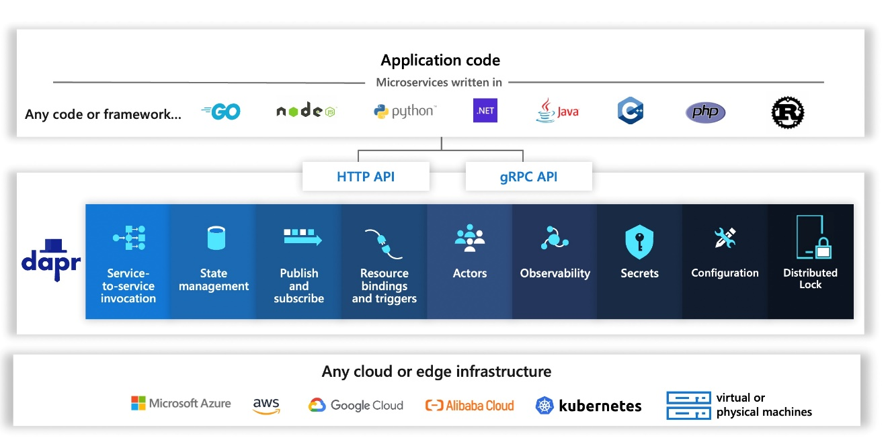
Distributed applications
Microsoft Orleans
Cloud-native application framework for .NET – distributed .NET
Aligned with .NET versions
Orleans 4.0 => Orleans 7.0
Orleans 8.0
Dapr
Distributed application runtime
API for building portable and reliable microservices
Current version is 1.11.0 RC1
Notes:
https://github.com/dotnet/orleans
https://devblogs.microsoft.com/dotnet/whats-new-in-orleans-7/

Slide 51
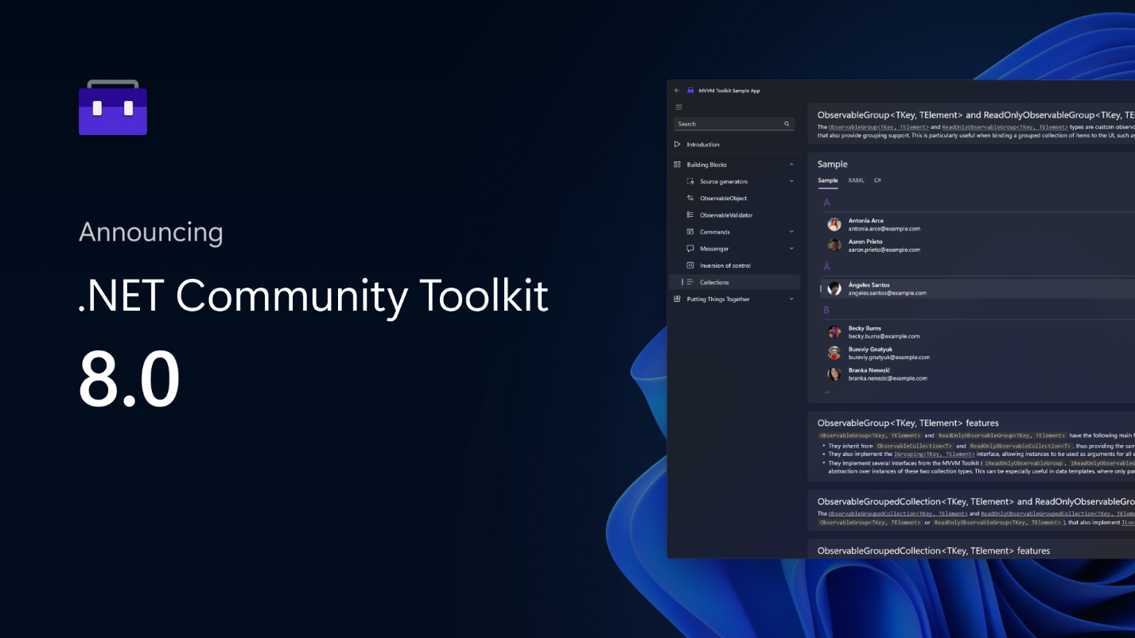
.NET Community Toolkit
Helpers and APIs for any UI platform
MVVM Toolkit
Inspired by MvvmLight
Source generators
Commands
Observable properties
Roslyn analyzers
Sample app
Other toolkits
Windows Community Toolkit
.NET MAUI Community Toolkit
Notes:
https://learn.microsoft.com/en-us/dotnet/communitytoolkit/introduction

Slide 52
Cloud and dogfooding
AppService is using Kestrel + YARP
Azure Functions supports .NET 7
Amazon EC2 and AWS Lambda support .NET 7
Azure Active Directory Gateway on .NET 6
Microsoft Graph on .NET 6
Azure Cosmos DB on .NET 6
Exchange Online on .NET 6
Dynamics 365 is using YARP
Microsoft Commerce on .NET 6
Microsoft Teams Infrastructure and Assignments on .NET 6
Bing Ads on .NET 6
OneService on .NET 6
Bing from .NET 5 to .NET 7+
Notes:
https://github.com/miroslavpopovic/what-is-new-in-dotnet#cloud-and-dogfooding

Slide 53

Visual Studio
Visual Studio is a 64-bit application, also Arm64
Git improvements – multi-branch, line staging, graphs…
Hot Reload
All-in-one search, find in files is a lot faster
Theming support and VS Code themes, UI refresh
Dev Tunnels for web applications [preview]
C# tools updates
IntelliCode, quick fixes and refactoring, new Razor editor...
Extension for .NET Framework to .NET migration
Visual Studio extensibility improvements
Performance improvements
…
Notes:
https://visualstudio.microsoft.com/vs/

Slide 54

Visual Studio Code
https://vscode.dev/
Visual Studio Code Server
.NET Interactive - .NET Notebooks
C#, F#, PowerShell, JavaScript, HTML, T-SQL
…
Notes:
https://devblogs.microsoft.com/dotnet/announcing-visual-studio-code-extension-for-tye/

Slide 55

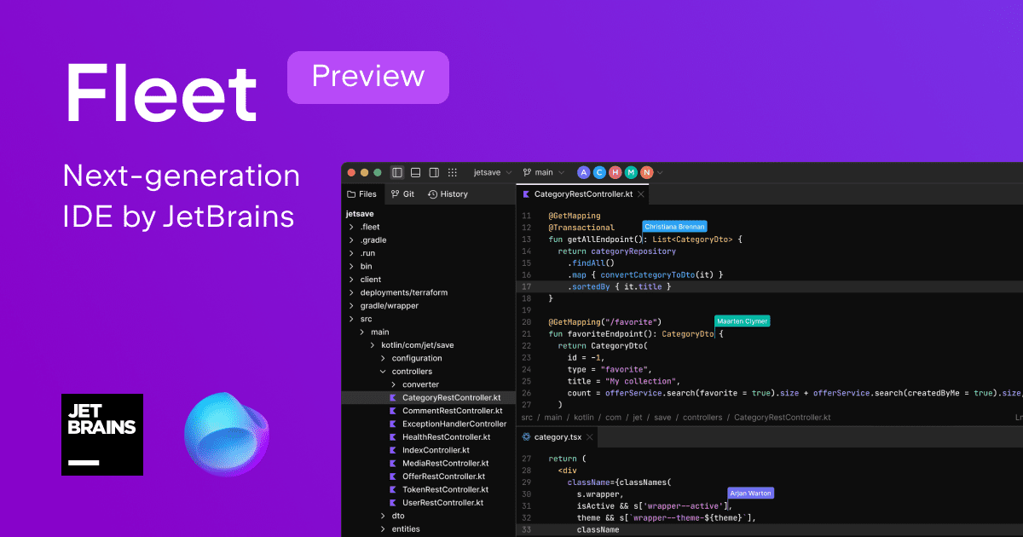


JetBrains
ReSharper
Rider
Fleet

Slide 56
Modern dev tools

Slide 57
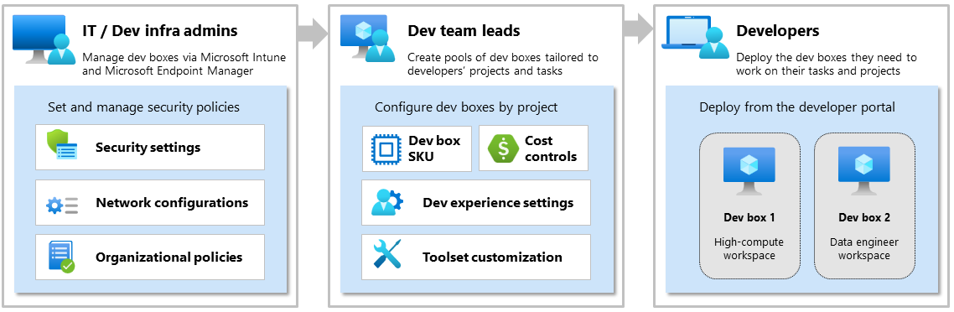
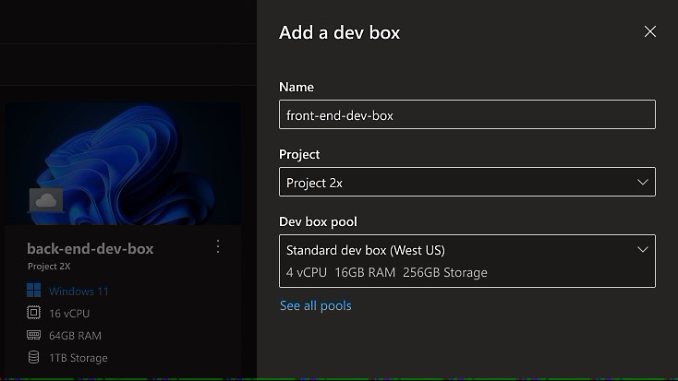
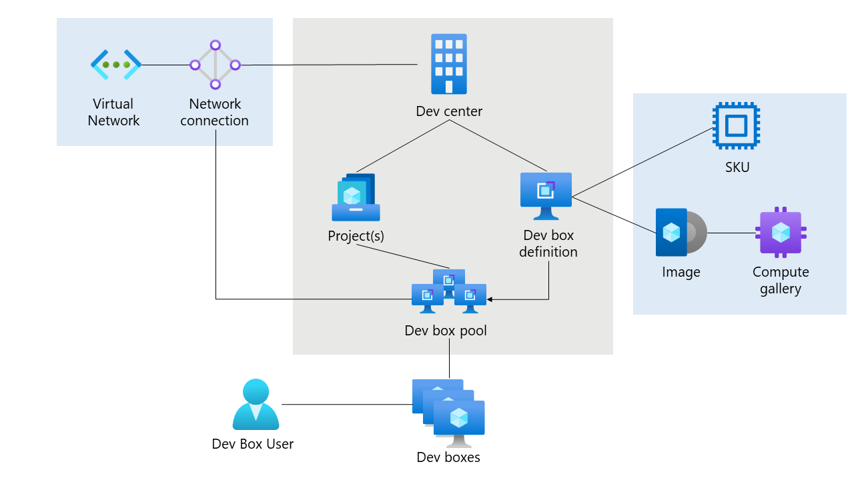
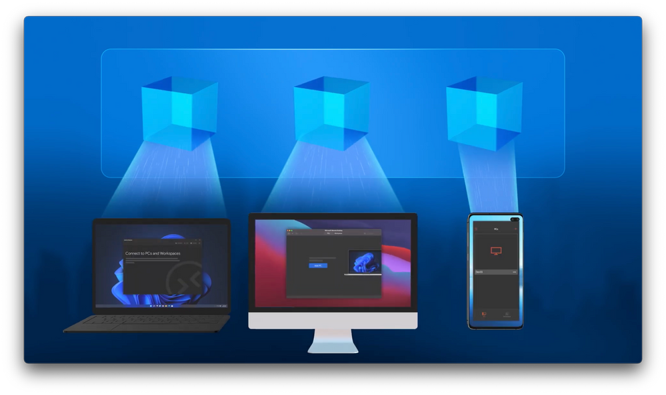
Microsoft Dev Box – cloud workstations
Notes:
https://azure.microsoft.com/en-us/blog/announcing-microsoft-dev-box-preview/

Slide 58
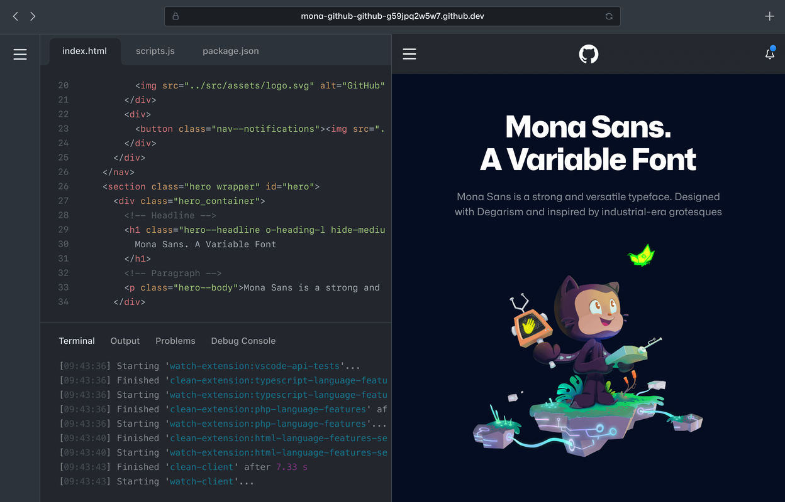
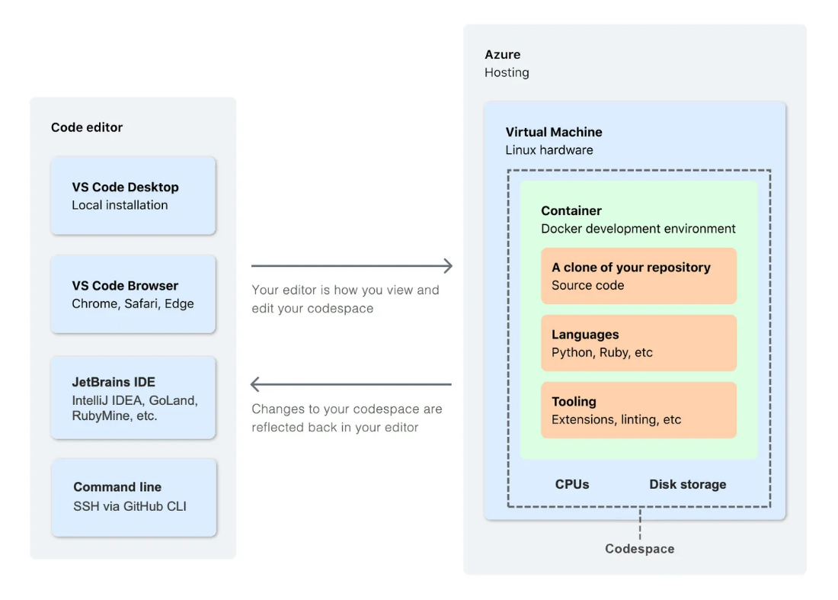
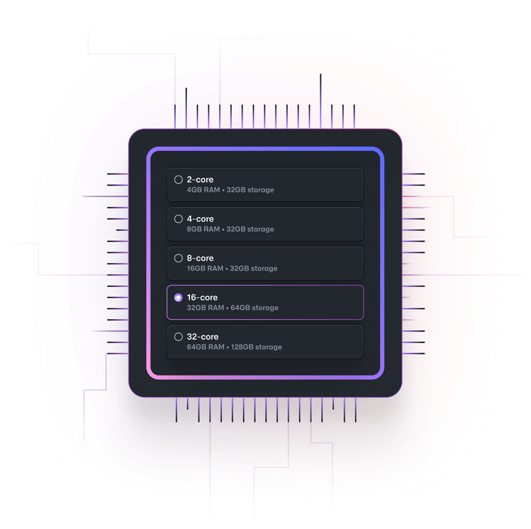

GitHub Codespaces
Notes:
https://docs.github.com/en/codespaces

Slide 59
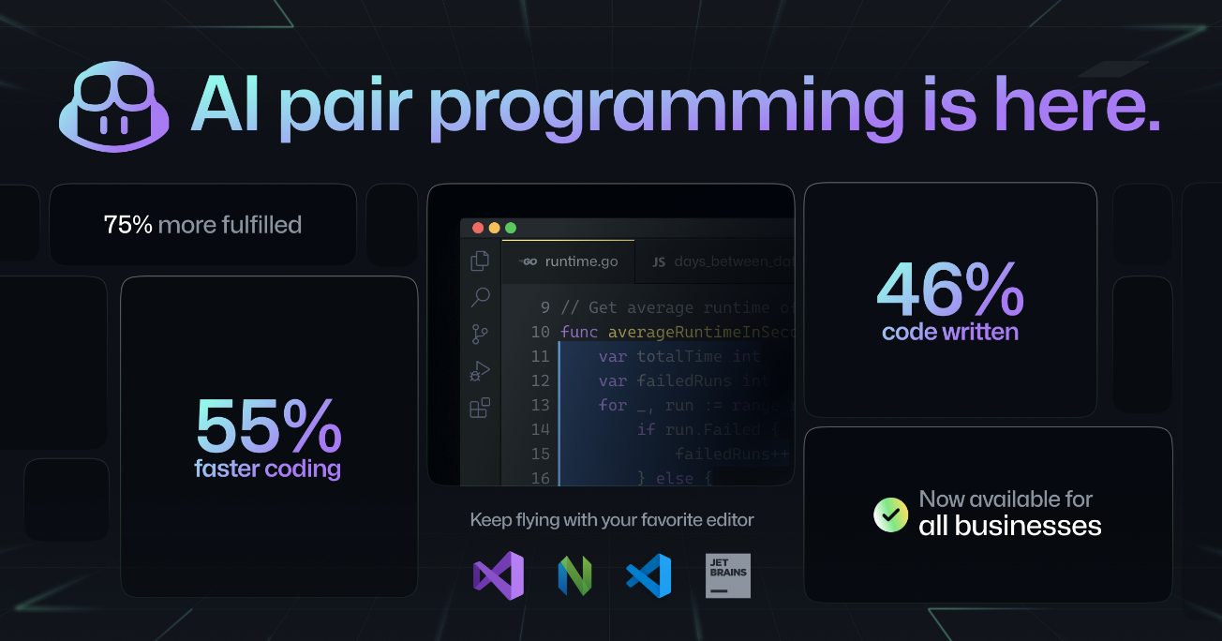
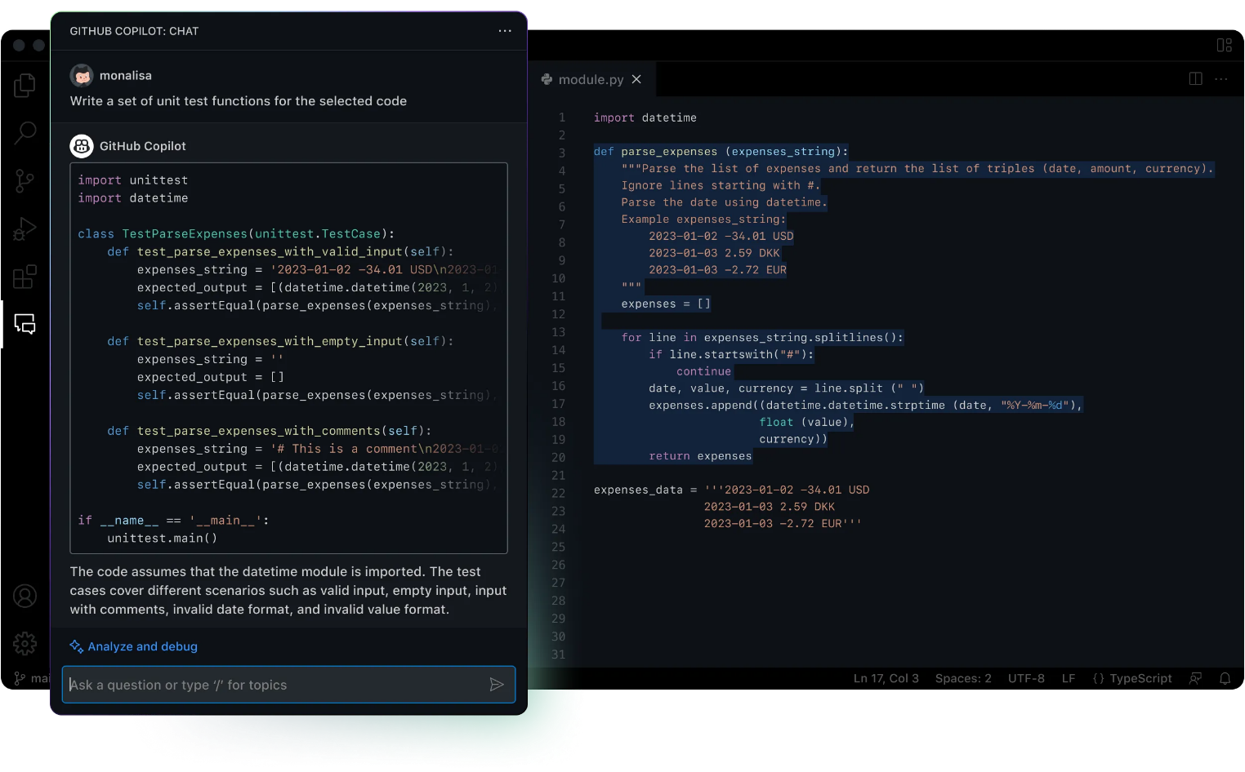

GitHub Copilot and Copilot X
Notes:
GitHub Copilot X – Chat (explain code, generate unit tests, etc.), for CLI, for Docs, for Pull Requests (description and tests), Voice

Slide 60
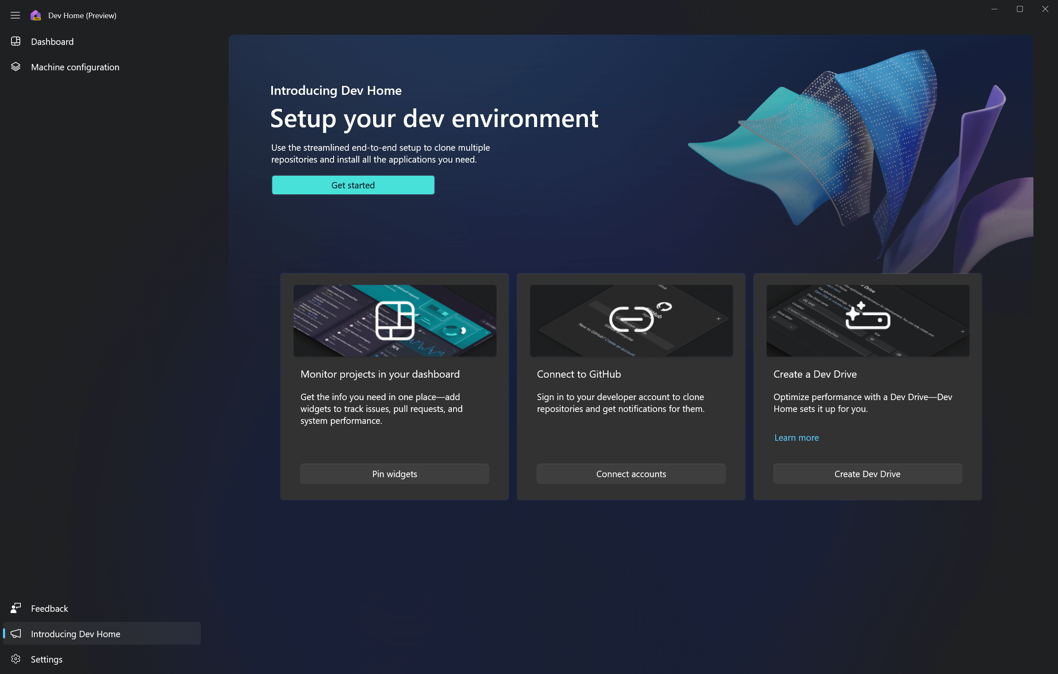
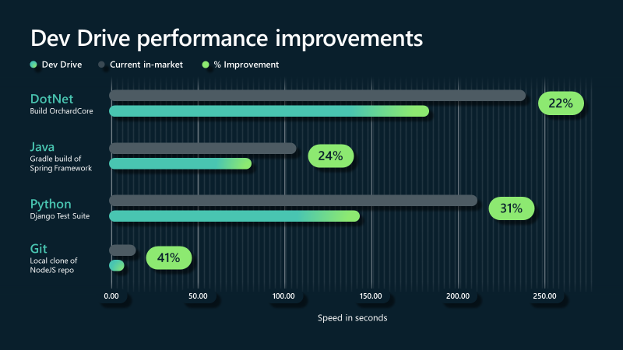
Dev Home and Dev Drive
Notes:
https://learn.microsoft.com/en-us/windows/dev-home/

Slide 61

Closing up...

Slide 62
Which .NET version to use?
.NET Framework 4.x
No!
Migrate
Reconsider architecture
.NET LTS
.NET 6, .NET 8...
For published projects that are in maintenance mode
.NET Current
.NET 7, .NET 9...
For projects in active development

Slide 63
The future
https://themesof.net/
https://www.dotnetconf.net/ ?
AI everywhere?

Slide 64
References
.NET Blog
https://devblogs.microsoft.com/dotnet/
.NET on YouTube – community standups, etc.
https://www.youtube.com/dotnet
Themes of .NET
https://themesof.net/
C# proposals
https://github.com/dotnet/csharplang/tree/main/proposals

Slide 65

@miroslavpopovic, https://miroslavpopovic.com/ https://github.com/miroslavpopovic/what-is-new-in-dotnet
THANK YOU

